Slide 1

VIRTUAL E-COMMERCE
(AUGMENTED REALITY)

Slide 2

Team Members
Ch. Kamal 18641A05E2
E. Srikanth 18641A05D4
G. Chandan 18641A05D8
K. Rohith 18641A05E7
K. SaiSanthosh 18641A05E4
Guide : Mrs.K. Rekha Devi
Assistant Professor

Slide 3

ABSTRACT:
With the introduction of smartphones, tablets, and other electronic devices, we can enjoy online shopping anytime and while sitting anywhere in the world. Online shopping has certainly replaced the traditional way of shopping for daily goods and clothing. Here, they enjoy easy access to an attractive price range, prompt customer support, and free home delivery.
Companies are using advanced recommendation algorithms to recommend appropriate clothes based on our previous purchases and our interests. There is no doubt that these are some of the attractive features that catch the attention of consumers.
Although there is one small issue that could make people lose interest in online shopping, it might not be possible to try-on clothes in such cases.
Our motive here is to increase the time efficiency and improve the accessibility of clothes try on by creating a virtual dressing room environment.

Slide 4

INTRODUCTION
EXISTING SYSTEM
In other words, online shopping or e-shopping is a form of electronic commerce that allows consumers to directly buy goods or services from a seller over the Internet using a web browser.
With online shopping we are no longer required to visit malls to make a purchase.
More and more people have turned to the Internet to buy everything from food, clothes, houses, and groceries.
The idea of not having to wait in long queues or in traffic or search through racks of clothing looking for the items or being able to shop at any time—preferably in pajamas—has caused more people to turn to shop online.

Slide 5

PROPOSED SYSTEM
Buying apparel through e-commerce has certain limitations of trying apparel before buying it.
Here we are providing a virtual room to try apparel through an e-commerce website before buying it.
So that users are motivated to buy online apparel through an e-commerce website and have lesser chances of returning and canceling of apparel because of having a facility to try apparel through a virtual room.

Slide 6

SYSTEM REQUIREMENTS
Windows* 7, Vista, XP Me,2000,or 98SE;
Intel* Pentium* IV 500 MHZ or higher
256 MB RAM
200 MB free hard drive space
Available USB 1.1 OR 2.0 Port (USB 2.0 Recommended)

Slide 7

software
Requirements
Python
OpenCV framework
Visual Studios(IDE)
Flask
HTML
CSS
Java Script

Slide 8

Technologies we used:
Open CV
dlib
numpy
cmake
scipy
gunicorn

Slide 9

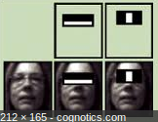
OBJECT DETECTION: FACE DETECTION USING HAAR CASCADE CLASSIFIERS
"Face detection is a computer technology that determines the locations and sizes of human faces in arbitrary (digital) images. It detects facial features and ignores anything else, such as buildings, trees, and bodies.
OpenCV's algorithm is currently using the following Haar-like features which are the input to the basic classifiers.

Slide 10

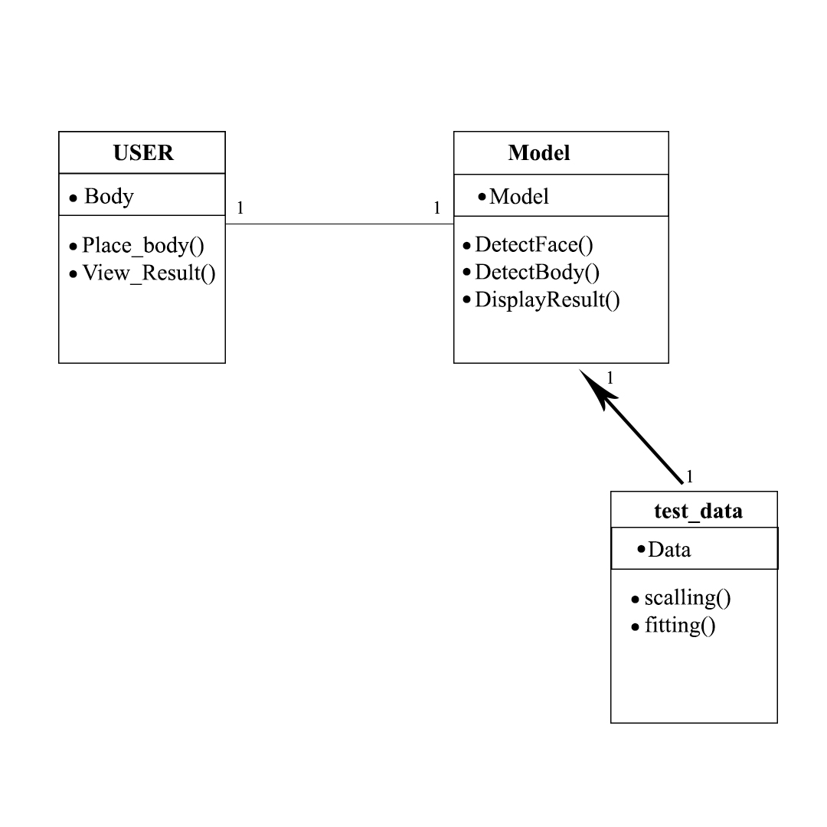
CLASS DIAGRAM

Slide 11
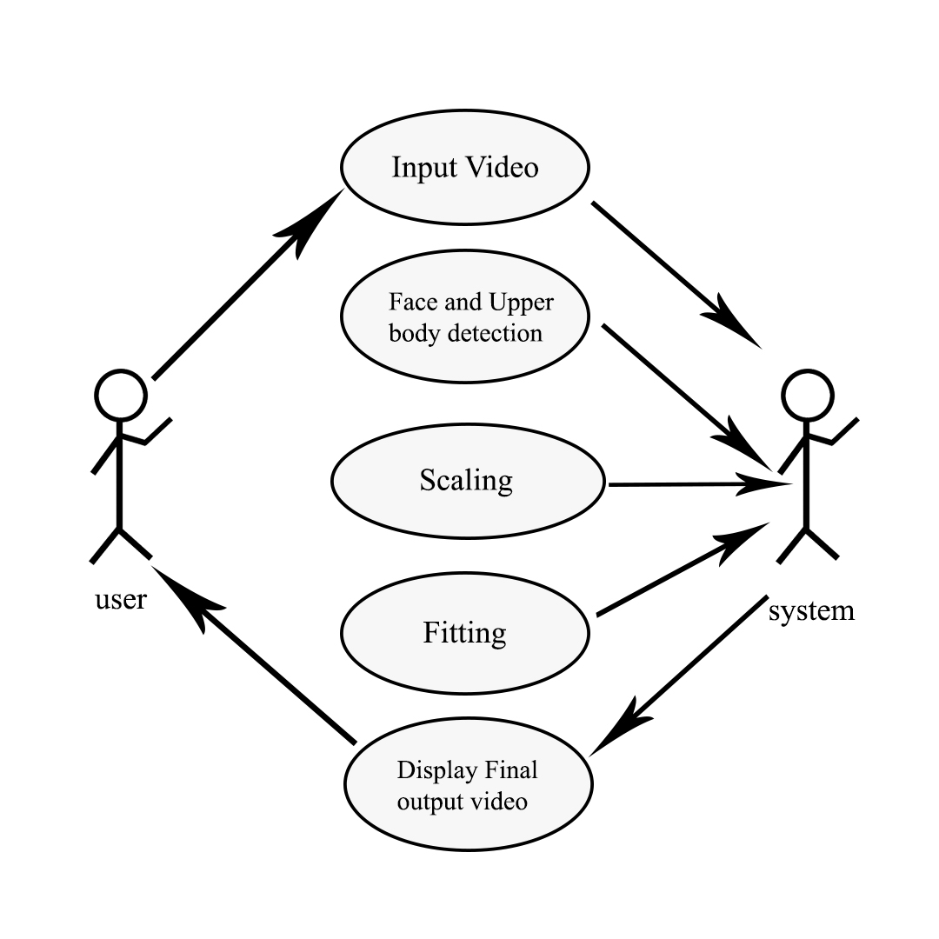
USE CASE DIAGRAM

Slide 12

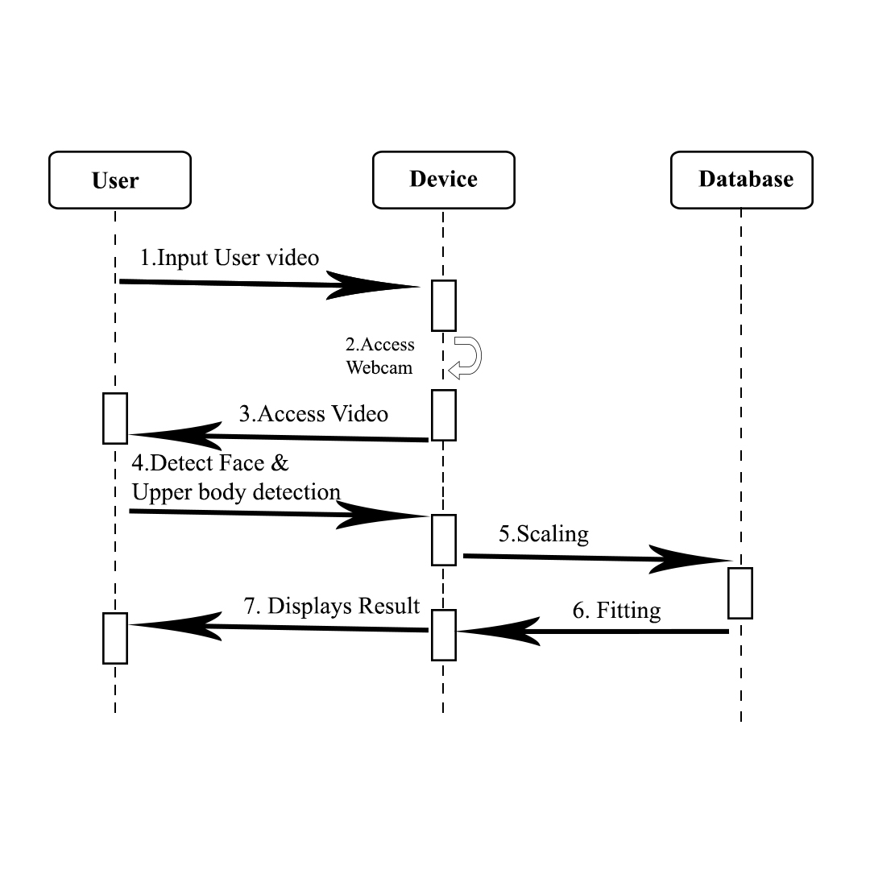
SEQUENCE DIAGRAM

Slide 13

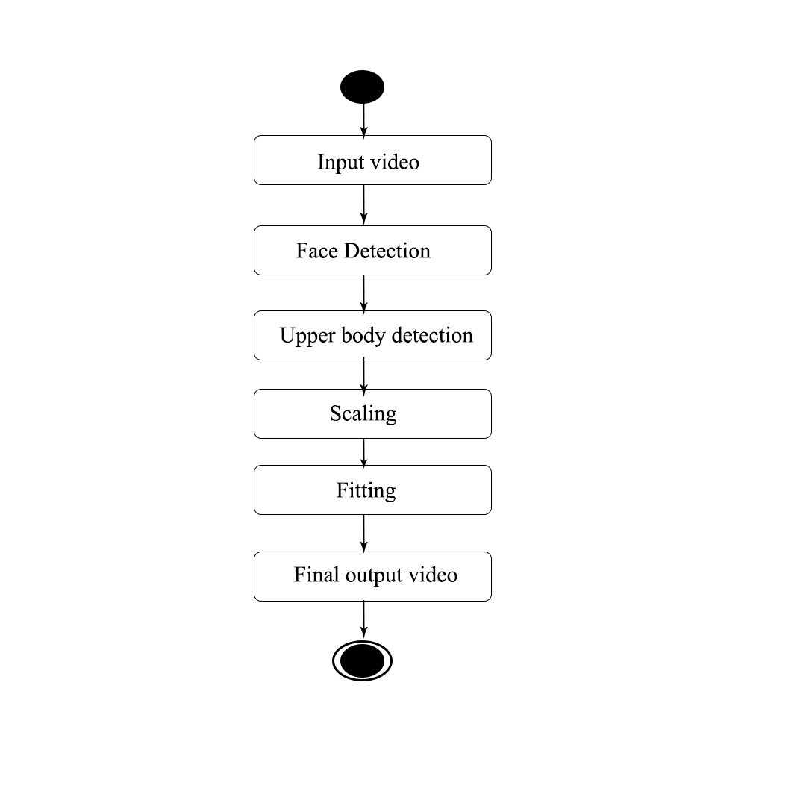
ACTIVITY DIAGRAM

Slide 14
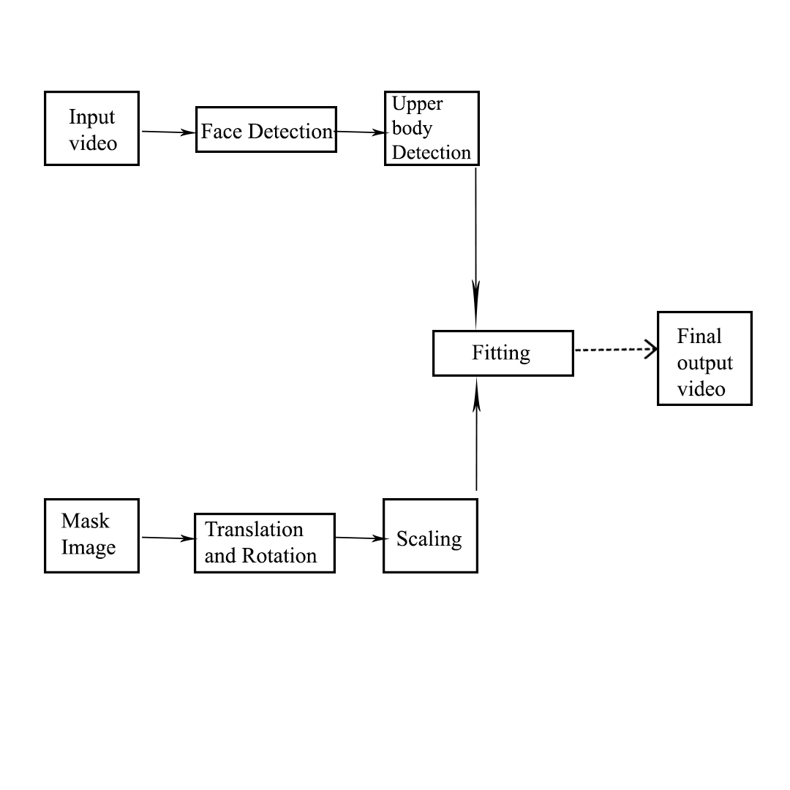
DATAFLOW DIAGRAM

Slide 15

EXECUTION

Slide 16

Conclusion & Future Scope
The Project developed allows the user ,to some extent, to browse through apparels and garments along with augmented reality providing perspectives from different angles and distances.
After detecting body parts of target image there are certain operation we need to perform for make this accurate.
So for this we need to train three type of network through which we can set clothes on target image.
PAN (pose alignment network)
TRN (texture refinement network)
FTN (fitting network)
Addition of other accessories such as watches and shoes can also be implemented.

Slide 17

THANK YOU

